Slide 1

Bankruptcy Prediction
Interim Presentation
Group Members | Apoorva Garg Pranavi Krishamshetty Vishal Pandey Yash Vahi
Group Number | 3
Mentor | Mr. Animesh Tiwari
Team Lead | Yash Vahi

Slide 2
Project Journey : Stage One
Problem
Understanding
1
2
3
4
In this stage our aim will be to formulate hypothesis, understand the perspective and validate it

Slide 3
Problem Understanding
What is Bankruptcy
Bankruptcy is a legal process through which people or other entities who cannot repay debts to creditors may seek relief from some or all of their debts. In most jurisdictions, bankruptcy is imposed by a court order, often initiated by the debtor.
Hypothesis Formation and Perspective
A bank has hired a team of data scientist to predict whether companies taking loans from them are or will go bankrupt in the future and default on their payments to become NPA for the bank.
Broader Utilities of Predicting Bankruptcy
Predicting bankruptcy is not just beneficial for banks giving loans, companies that are going bankrupt can benefit from identifying tell-tale signs of bankruptcy and stop it in its tracks.

Slide 4
Project Journey : Stage Two
Problem
Understanding
Data Analysis
1
2
3
4
In this stage our aim will be to collect as much information as we can about the data set to make future decisions

Slide 5
Data Description & Basic Analysis
The Dataset we’re working with contains financial information in the form of ratios about companies in Taiwan.
Shape : 6819 rows and 96 columns
No null/duplicate values
All features are numerical
Columns like “Net Income Flag” and “Liability Assets Flag” are insignificant for further analysis.
Most features are contained within the range 0-1.

Slide 6
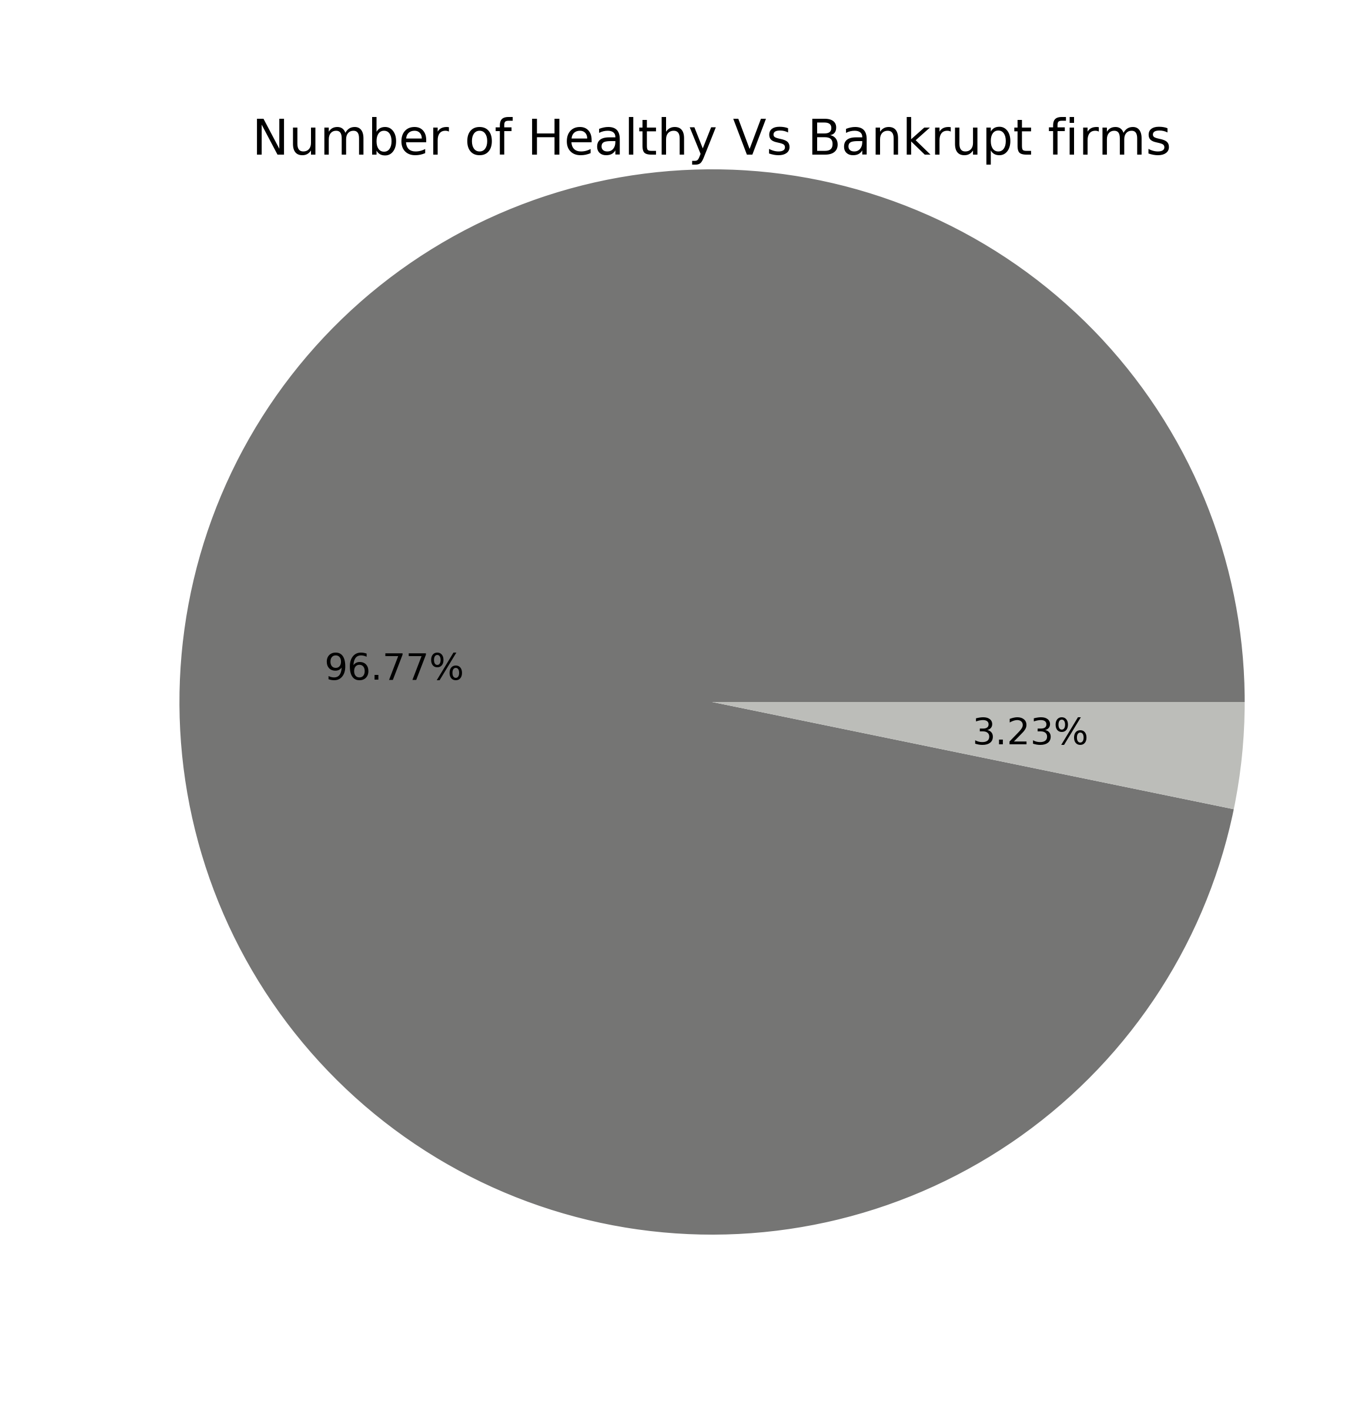
Analysis of Target Variable
Problem
There are way more Healthy firms than Bankrupt firms in the dataset
Almost 97% firms are Healthy
Non bankrupt Firms : 6599
Bankrupt Firms : 220
Impact
Class imbalance impacts performance metrics like accuracy ,precision and F1 Score.
Reducing Impact
Impact can be reduced by under-sampling or over sampling.

Slide 7
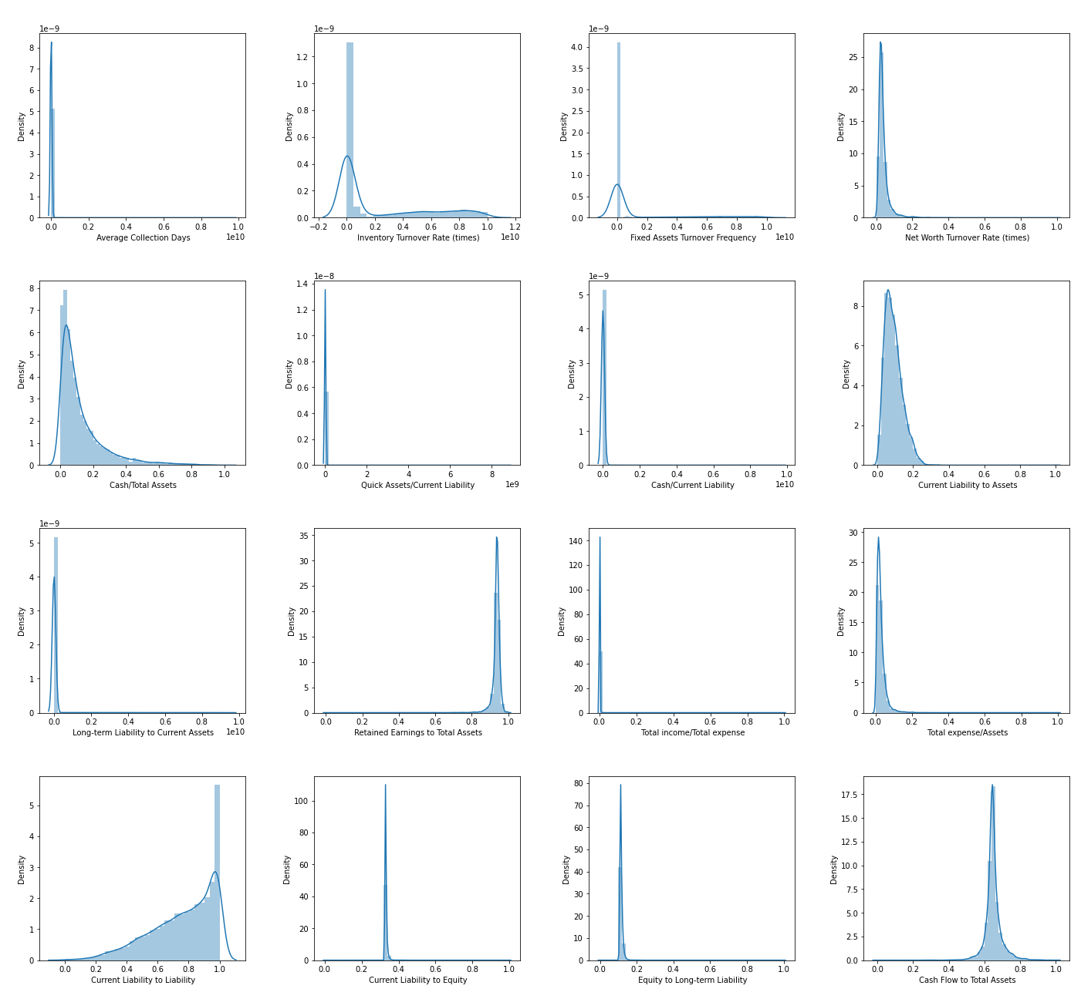
Distribution & Outlier Analysis
Most Features are highly skewed and leptokurtic, pointing towards extreme outliers. Transformation techniques need to be applied
Our outlier analysis using boxplots did in fact show us that most features have extreme outliers.
Some common methods of treating outliers are IQR and Zscore elimination

Slide 8
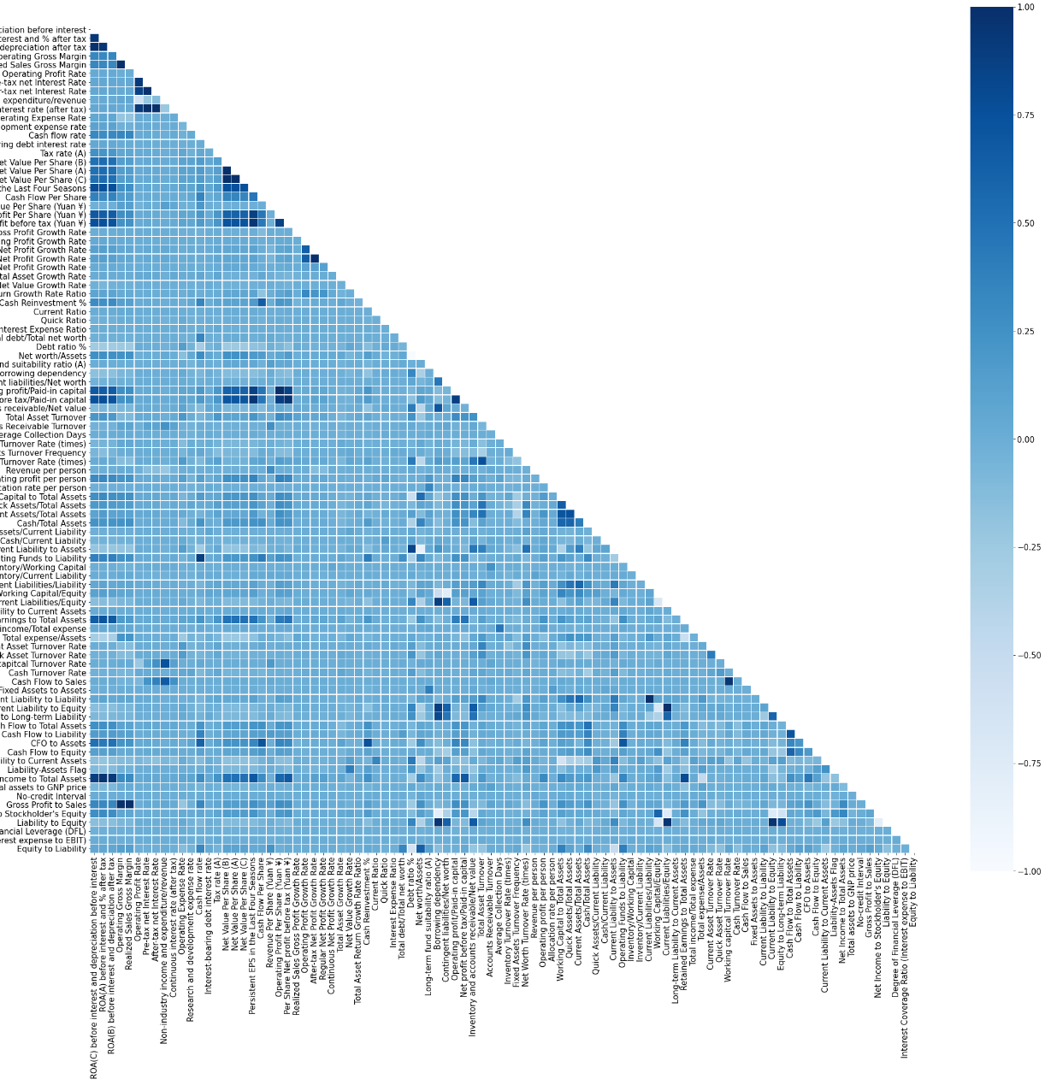
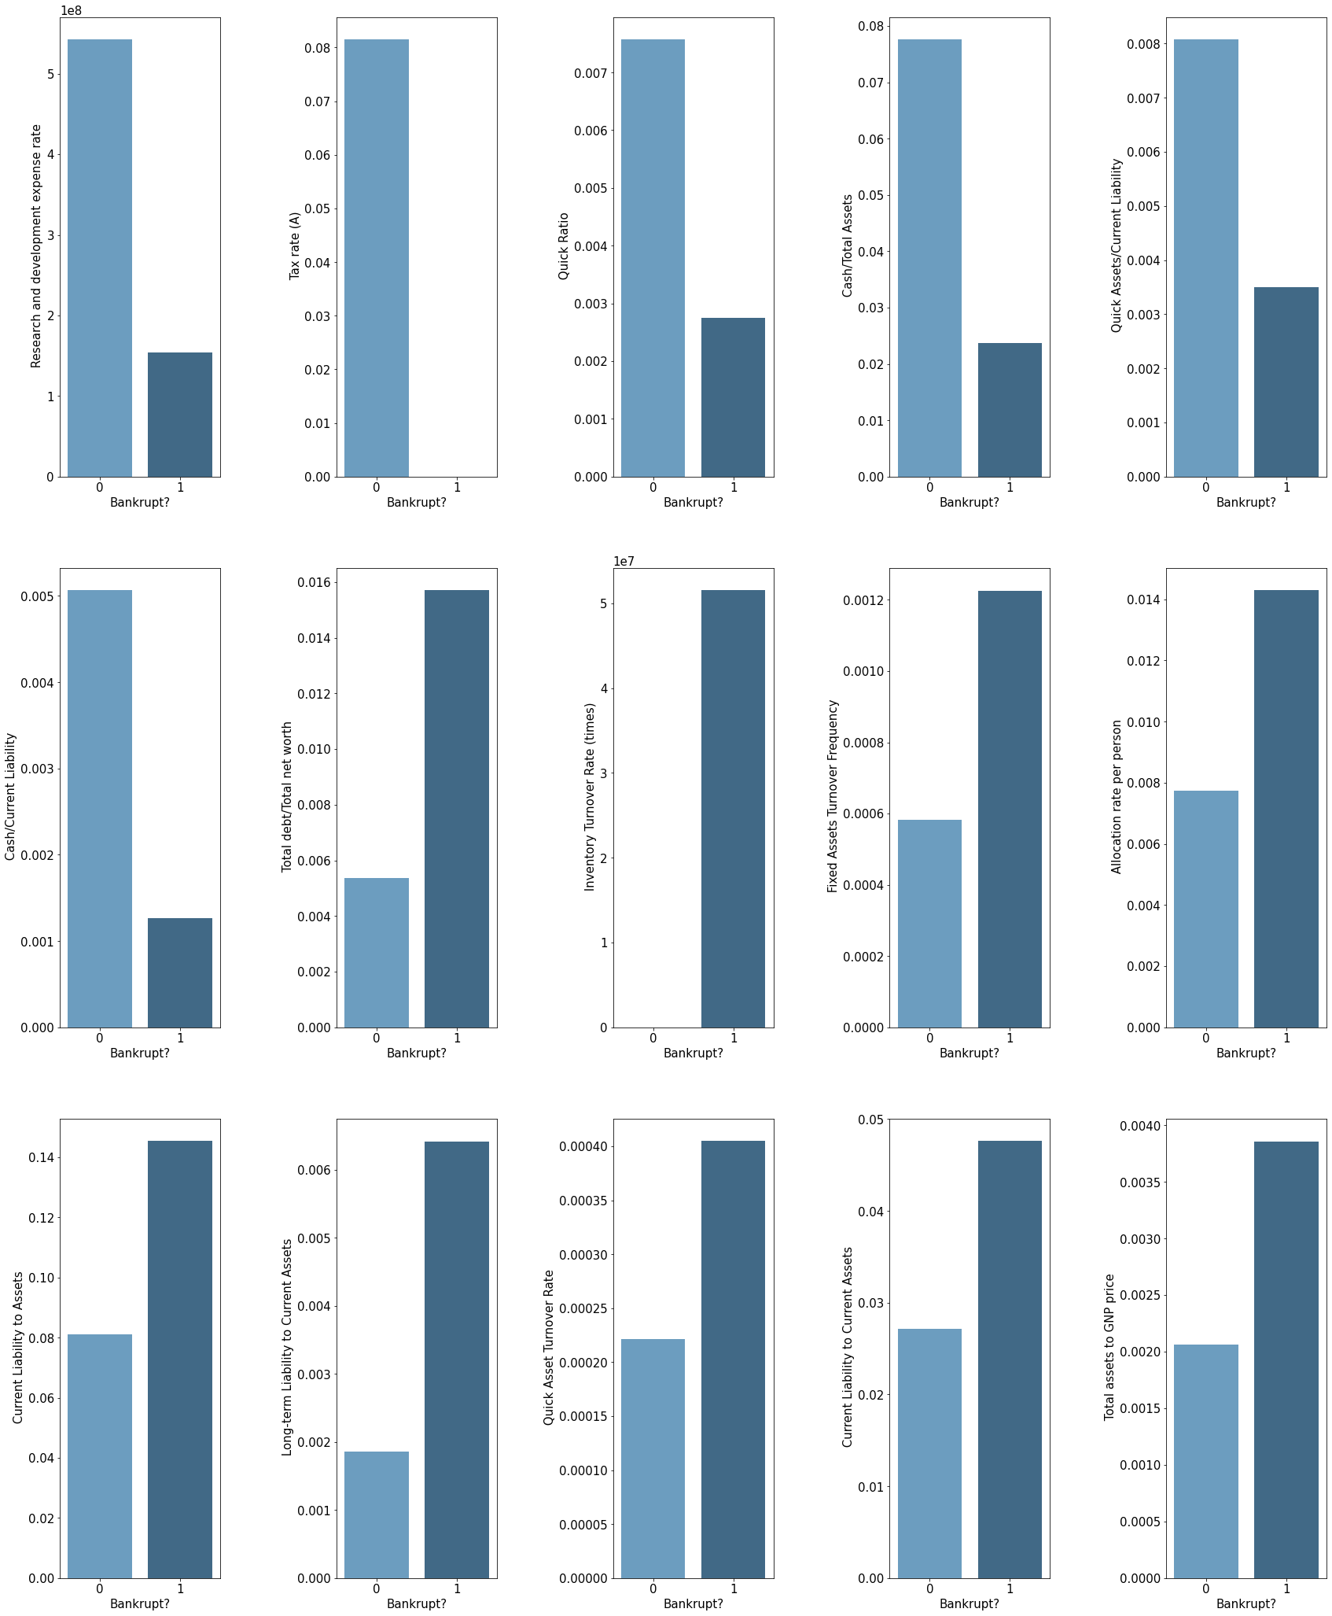
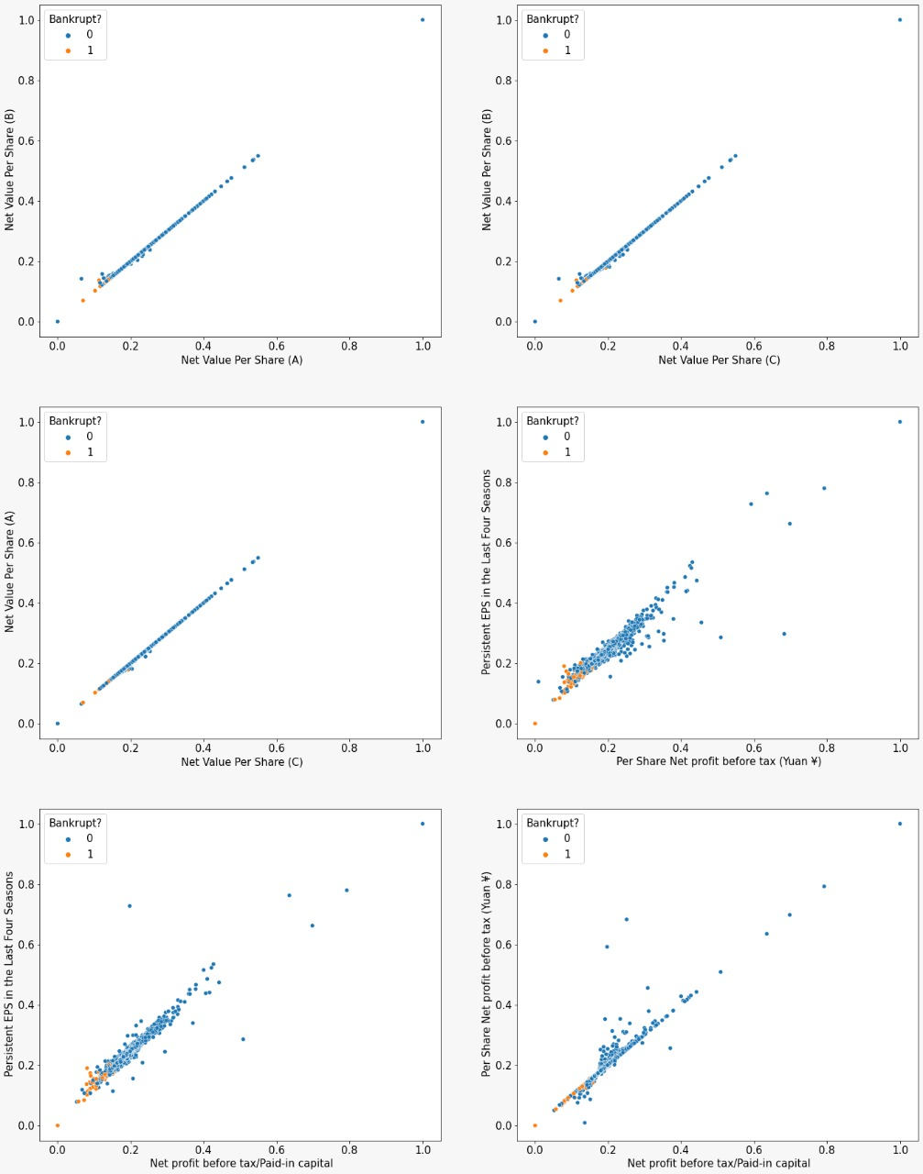
Bivariate and Multivariate Analysis
Correlation Analysis
Bivariate Analysis
Multivariate Analysis
High-extreme correlation between some of the independent variables. We found 77 distinct pairs of independent features that had correlation greater than 0.7 or less than -0.7.
Companies with low Research and development expense rate, Tax rate (A),Quick Ratio, Cash/Total Assets, Quick Assets/Current Liability and Cash/Current Liability tend to go bankrupt.
Companies with high Total debt/Total net worth, Inventory Turnover Rate (times),Fixed Assets Turnover Frequency, Allocation rate per person, Current Liability to Assets, Long-term Liability to Current Assets, Quick Asset Turnover Rate, Current Liability to Current Assets and Total assets to GNP price1 tend to go bankrupt.
Companies with low Net value per share tend to go bankrupt.
Companies with low Persistent EPS in the last four years, Per share net profit before tax, Net profit before tax/paid in capital tend to go bankrupt.

Slide 9
Project Journey : Stage Three
Problem
Understanding
Data Analysis
Data
Preparation
1
2
3
4
In this stage, we will clean our data and get it ready for modeling.

Slide 10
Data Preprocessing
Outlier Treatment
We first removed all the outliers using the IQR method.
We transformed all the features that had absolute skewness > 1 using square root.
Then we normalized the features to get it ready for KNN imputation.
At last, we imputed the null values using KNN imputation.
Multicolinearity reduction
We used the Variance inflation factor(VIF) to filter out features exhibiting multicollinearity(VIF>5).
We were left with 48 columns.
Train-Test split
We performed a 70:30 split. We also added a constant before splitting.

Slide 11
Project Journey : Stage Four
Problem
Understanding
Data Analysis
Data
Preparation
Modeling
1
2
3
4
Now that our Data is ready, we can begin constructing predictive models

Slide 12
Logistic Regression
01
Build full Logit Model
Calculate ROC-AUC. Calculate recall at youdens index
02
GOAL
Recall maximized at 0.974, with only 2 misclassifications of bankrupt companies at the cost of precision
C1
Full ROC : 0.955
Full Recall :0.948
C2
Full ROC : 0.959
Full Recall :0.974
C3
Choose RFE model at
youdens index thresh
01
Build RFE logit model
Calculate ROC-AUC. Calculate recall at youdens index
02

Slide 13
Future Focus
Build and explore the following models:-
Decision Tree
Bagging : Random Forest
Boosting : Ada, XG, LG (helps improve recall and precision)
K-Nearest Neighbors
Naïve Bayes
Compare all our best models using metrics like recall, roc-auc, kappa, f1 with recall being the priority.
After picking the best model, analyzing coefficients, feature significance/importance.

Slide 14

Thank You! The floor is open for questions…

